Slide 1
Graph Databases

Slide 2
Pitfalls of Relational Databases :
Relational databases were initially designed to codify paper forms and tabular structures.
As outlier data multiplies, and the overall structure of the dataset becomes more complex and less uniform, the relational model becomes burdened with large join tables, sparsely populated rows, and lots of null-checking logic.
The rise in connectedness translates in the relational world into increased joins, which impede performance and make it difficult for us to evolve an existing database in response to changing business needs.
High Costs in some cases where expensive joins are required.
Foreign key constraints add additional development and maintenance overhead just to make the database work.

Slide 3
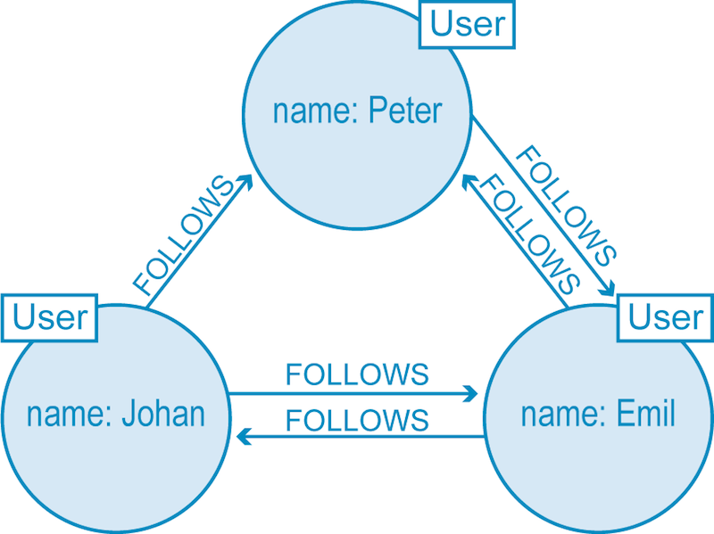
Graph Databases definition :
A graph database, also called a graph-oriented database, is a type of NoSQL database that uses graph theory to store, map and query relationships.
Based upon the concept of a mathematical graph, a graph database contains a collection of nodes and edges. A node represents an object, and an edge represents the connection or relationship between two objects.
Relationship between users of a social networking

Slide 4
Components :
Node :
Nodes represent entities or instances such as people, businesses, accounts, or any other item to be tracked.
Each node is identified by a unique identifier that expresses key value pair.
Edge :
Edge is the line that connects nodes to other nodes; representing the relationship between them.
Edges are the key concept in graph databases, representing an abstraction that is not directly implemented in a relational model or a document-store model.
Properties :
Properties are germane information to nodes.
Example : Facebook is a website, word starting with letter F ,etc.

Slide 5
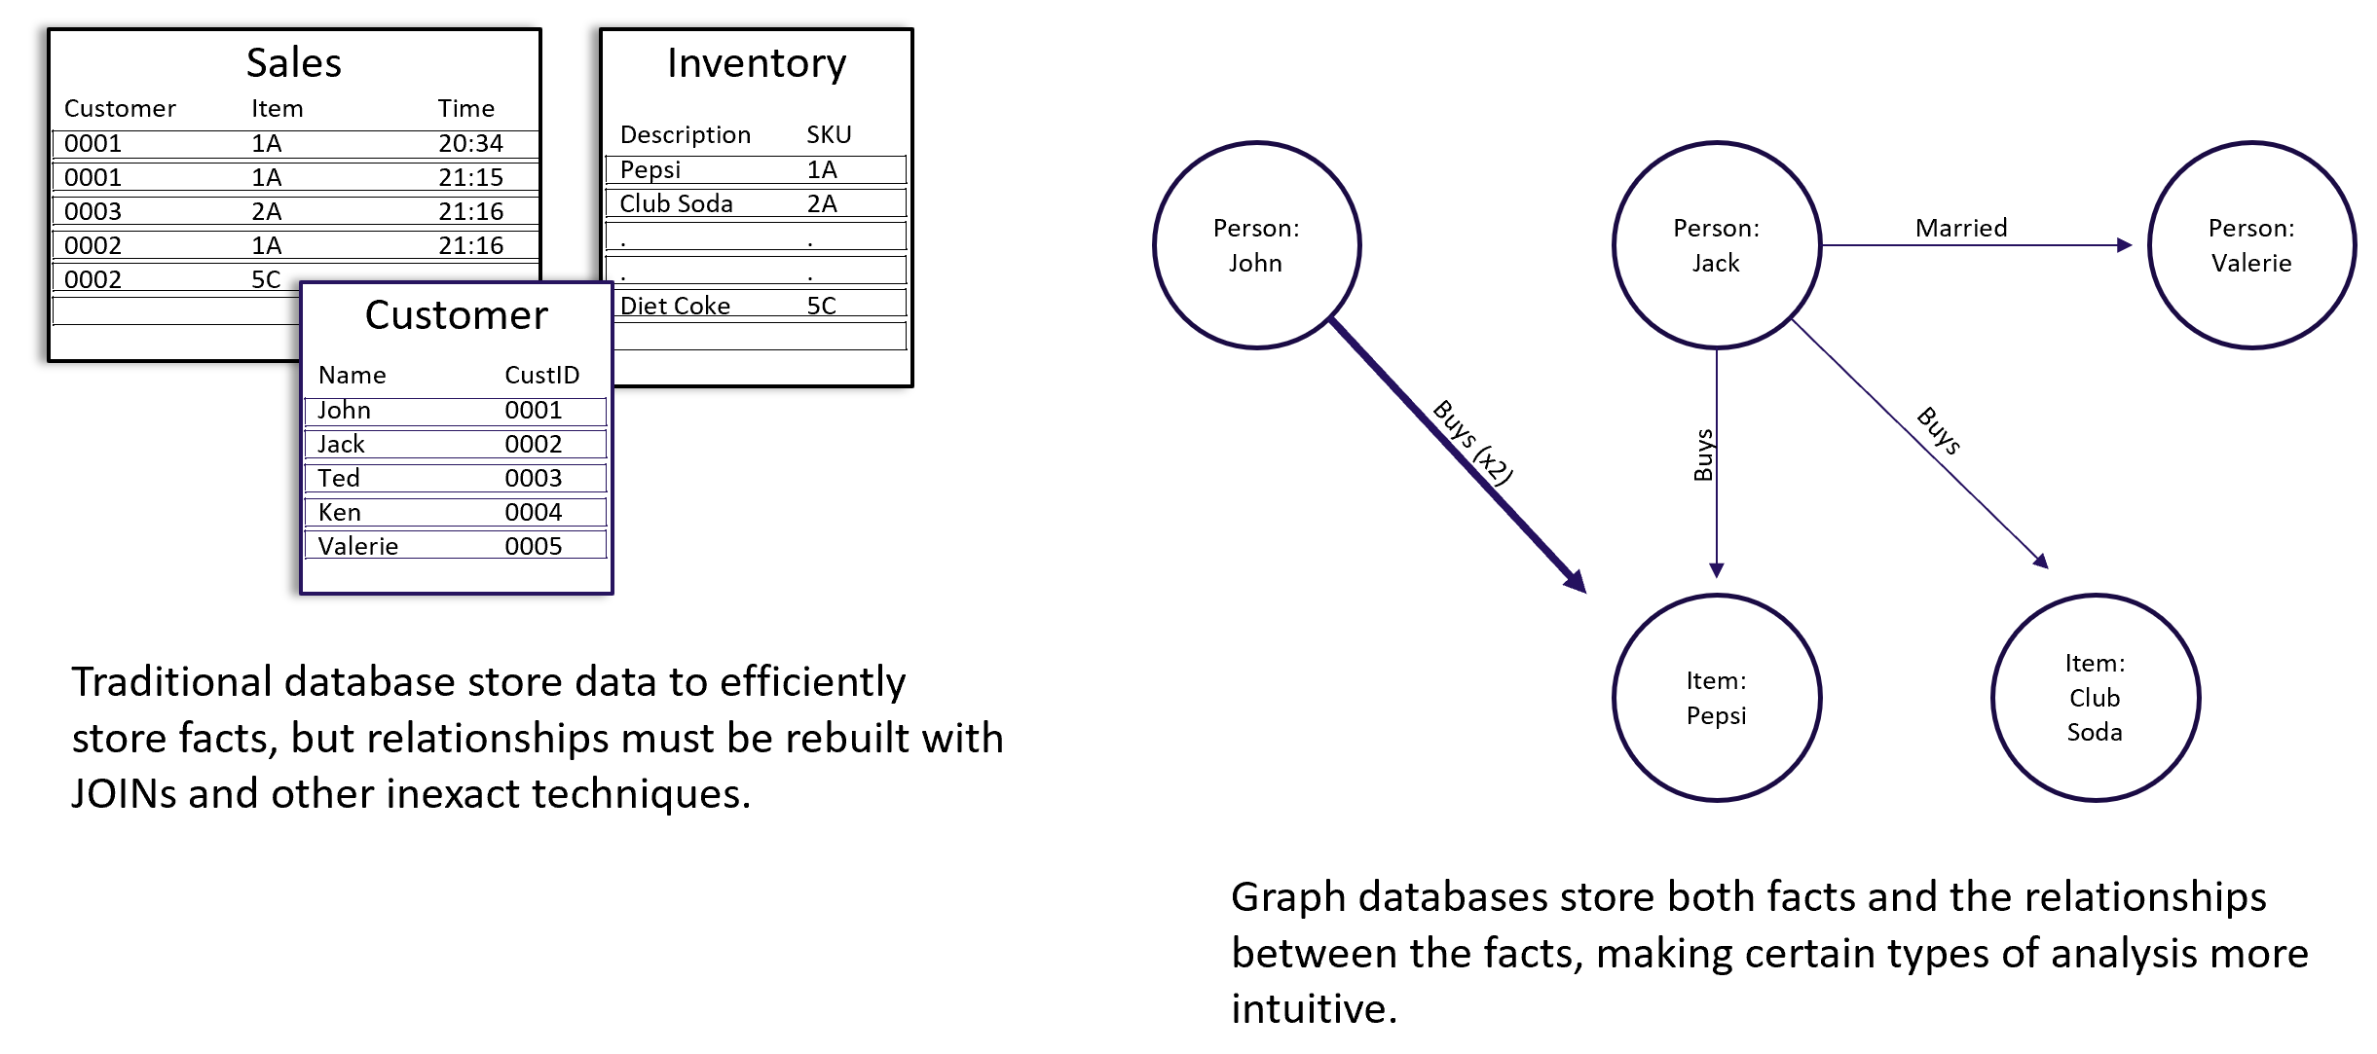

Slide 6
Properties of Graph Databases :
The underlying storage : Two types of storages – Native and Non-native.
When built specifically for storing graph-like data, it is known as native graph storage.
Graph databases with native graph storage are optimized for graphs in every aspect, ensuring that data is stored efficiently by writing nodes and relationships close to each other.
Graph storage is classified as non-native when the storage comes from an outside source, such as a relational , wide-column or other NoSQL databases.
These databases store data about nodes and relationships, which may end up far apart in actual storage. This non-native approach leads to latent results as their storage layer is not optimized for graphs.

Slide 7
The processing engine :
Native graph processing is another key element of graph technology, referring to how a graph database processes database operations, including both storage and queries.
Index-free adjacency is the key differentiator of native graph processing.
Index-free adjacency means that connected nodes physically “point” to each other in the database.
A significant performance is obtained by the use of index-free adjacency .
Index-free adjacency speeds up processing by ensuring that each node is stored directly to its adjacent nodes and relationships. Then, during query processing index-free adjacency ensures lightning-fast retrieval without a heavy reliance on indexes.
Non-native graph processing often uses a large number of indexes in order to complete a read or write transaction, significantly slowing down the operation.

Slide 8
Native vs Non Native :
Datasets tend to growover time, and today’s datasets are more unstructured, interconnected and interrelated than ever before.
The performance of non-native graph processing cripples under larger datasets.
As more data is added to the database, many queries that would slow with size in a non-native graph database remain lithe and speedy in a native context.
Native graph scaling takes advantage of a large number of optimizations in storage and processing to yield a highly efficient approach.
Non-native uses brute force to solve the problem, requiring more hardware and resulting in lower latencies, especially for larger graphs.
The importance of native vs. non-native graph technology depends on the particular needs of your application, but for enterprises hoping to leverage the connections in their data, native graph database technology is critical for success.

Slide 9
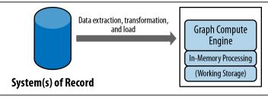
Graph Compute Engines :
A graph compute engine is a technology that enables global graph computational algorithms to be run against large datasets.
Graph compute engines are designed to do things like identify clusters in your data, or answer questions such as, “how many relationships, on average, does everyone in a social network have?”
High level view of graph compute engine deployment.
Common Architecture

Slide 10
Power of Graph databases :
Performance
Flexibility
Agility
Use cases :
Social
Recommendations
Geo
Master Data Management
Network and Data Center Management

Slide 11
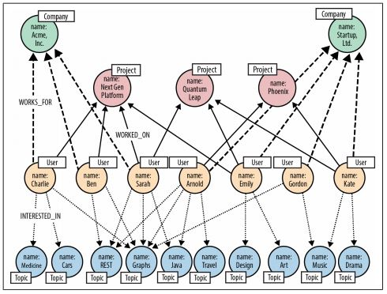
Real World example :
Social Network

Slide 12
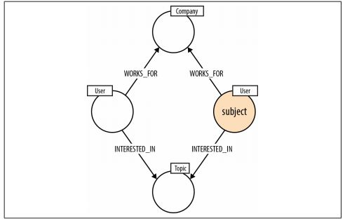
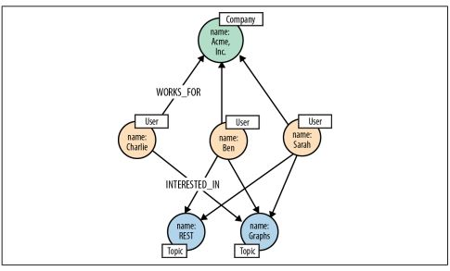
Pattern to find who shares same interests
Colleagues who share Sarah’s interests

Slide 13
Some of the graph databases :
NEO4J :
It is highly performance, scalable, and flexible. It is equipped with a rich UI, called the Neo4j browser, that is used for queries, visualization, and data interaction. It has compatibility with most programming platforms like Java, Nodejs, PHP, Python, .NET, etc.
It supports the Cypher query language, whose syntax naturally depicts data and relationships.
It has a good integration support with Apache Spark, Elastic search, MongoDB, Cassandra, and Docker.
ORIENT DB :
Orient DB is a high speed, scalable, and reliable GraphDB. It has a high and constant traversing speed that is not affected by database size.
User, role, and record level security is built-in. It has a good compatibility with most programming platforms like Java, Nodejs, PHP, Python, .NET, etc. It has a strong community support and is licensed under Apache 2.

Slide 14
TITAN DB :
Titan DB is highly scalable and can store and query graphs containing hundreds of billions of vertices and edges distributed across a multi-machine cluster.
Titan DB is transactional and supports various backend stores like Cassandra, HBase, and BerkeleyDB.
It supports integration with Elastic Search, Lucene, and Solr, and also supports the Gremlin query language. It is licensed under Apache 2.
APACHE GIRAPH :
It is an Iterative Graph processing framework backed by Apache Hadoop. Giraph jobs are highly scalable as they run on Hadoop Cluster.
Giraph can greatly increase the efficiency of graph computation on a huge dataset. It is licensed under Apache 2.
Apache TinkerPop :
It is an open source, vendor-agnostic, graph computing framework distributed under the commercial friendly Apache2 license. When a data system is TinkerPop-enabled, its users are able to model their domain as a graph and analyze that graph using the Gremlin graph traversal language.

Slide 15
Some of the popular graph query languages :
A great advantage of graph queries is that they eliminate the need to join multiple tables to find those relationships between your data points because the relationships are embedded in the data itself.
Cypher :
Cypher is a very popular declarative query language that was invented by the folks at Neo4j. Its popularity stems from its resemblance to SQL, so those with SQL experience will feel right at home.
SPARQL :
SPARQL is SQL-like declarative query language that was created by W3C to query RDF (Resource Description Framework) graphs.
GraphQL :
GraphQL (created by Facebook) is a query language for APIs that isn’t specific to graph databases. Users define the structure of the data they need and they get exactly what they asked for. GraphQL queries are organized as types and fields, and not as endpoints. By varying the request object, you can determine what gets returned by the server.

Slide 16
Gremlin
Germlin was created in 2009 and is the query language for Apache TinkerPop. It is a graph traversal DSL (Domain Specific Language) that can be either declarative or imperative. Gremlin is Groovy-based, but has many language variants that allow developers to write Gremlin queries natively in many modern programming languages such as Java, JavaScript, Python, Scala, Clojure and Groovy.
Applications :
Fraud Detection
Real-time Recommendation Engines
Master Data Management
Empowering Network & IT Operations
Identity & Access Management
Further Reading

